Slide 1
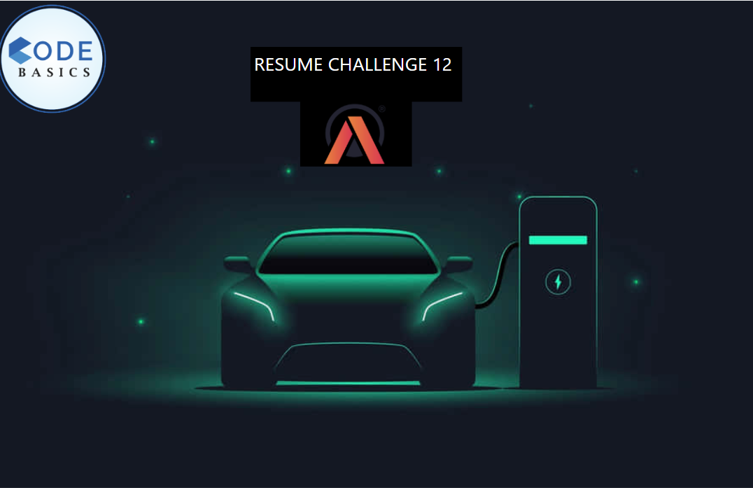

Slide 2

Introduction
Problem statement
Dashboard preview
Primary research question
Secondary research question
Recommendation
Conclusion

Slide 3




AtliQ Motors:
India EV/Hybrid Market Study Dashboard
Made by:
Harsh Wardhan Singh

Slide 4
AtliQ Motors: Pioneers in Electric Vehicle Innovation
Company Overview:
Founded in the USA, AtliQ Motors is a leading automotive manufacturer specializing in electric vehicles (EVs) and hybrid technology.
With a commitment to sustainability and innovation, AtliQ Motors has become a major player in the North American EV market.
Market Leadership:
In the past 5 years, AtliQ Motors has captured a 25% market share in the EV and hybrid vehicle
segment across North America.
The company is renowned for its cutting-edge technology, superior performance, and eco-friendly
vehicles.
Global Expansion Goals:
As part of its global expansion strategy, AtliQ Motors is now eyeing the Indian market, where EV adoption is on the rise.

Slide 5
Expanding AtliQ Motors into the Indian Market
Purpose:
AtliQ Motors aims to expand its market presence in India by launching its bestselling EV and hybrid models.
The goal is to significantly increase the market share from the current less than 2% to
a more competitive position.
Problem Statement:
Despite success in North America, AtliQ Motors has a minimal footprint in the Indian
market.
The challenge is to understand the dynamics of the Indian EV/Hybrid market and
identify key opportunities and threats.

Slide 6
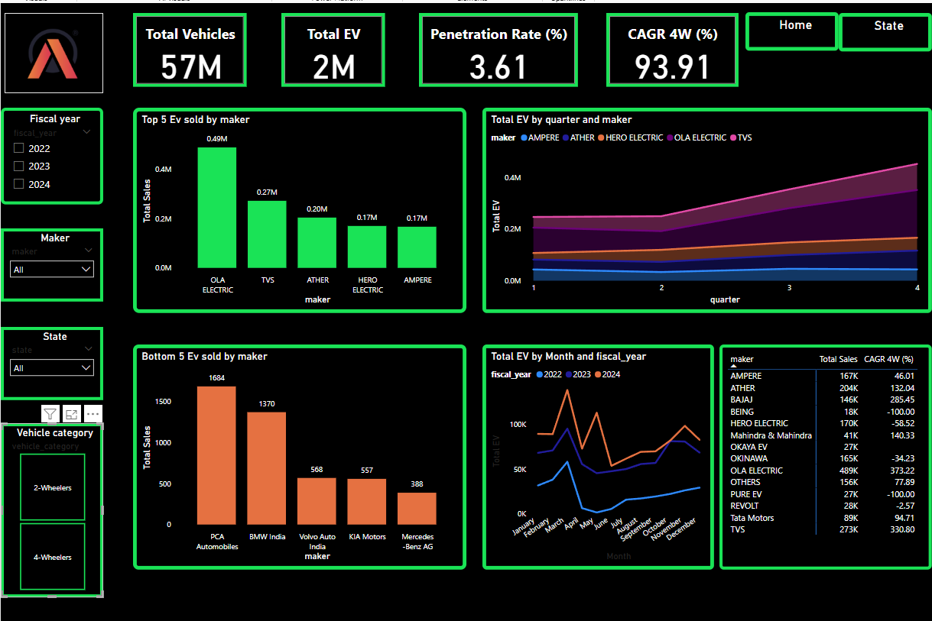

Slide 7
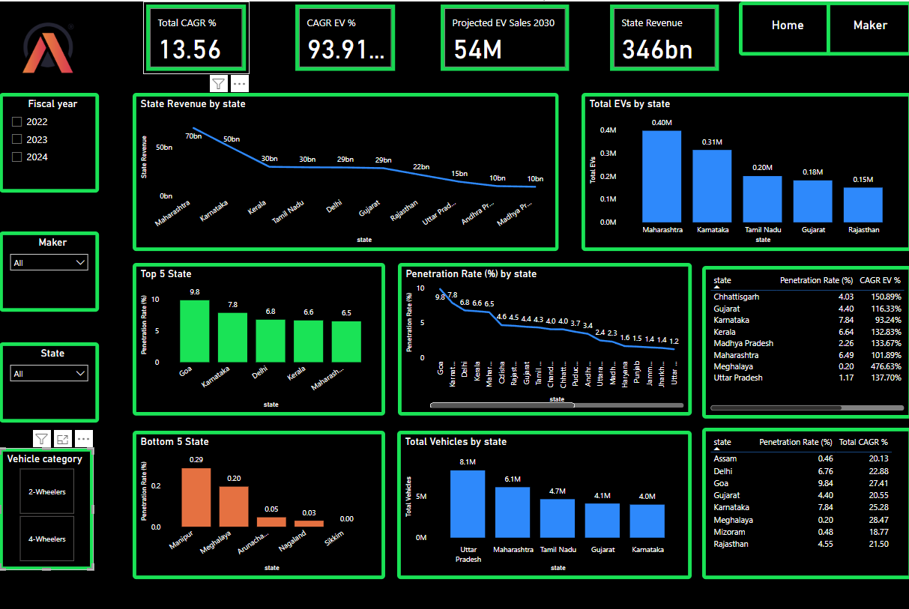

Slide 8
Preliminary Research Questions

Slide 9
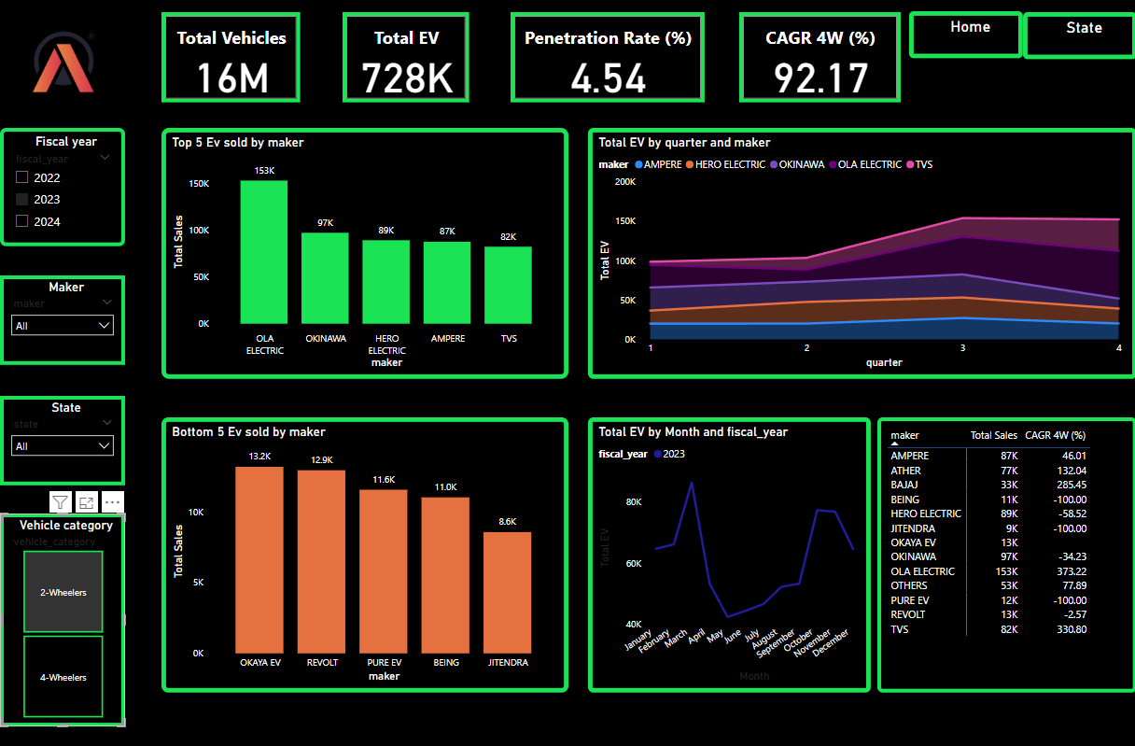
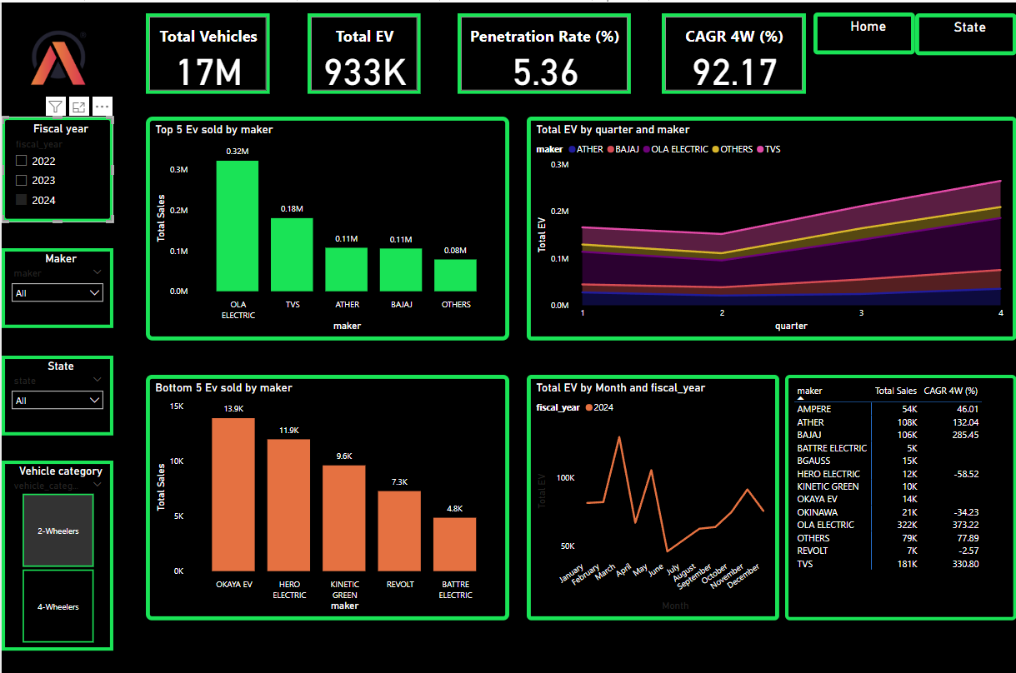
1. List the top 3 and bottom 3 makers for the fiscal years 2023 and 2024 in terms of the number of 2-wheelers sold.

Slide 10
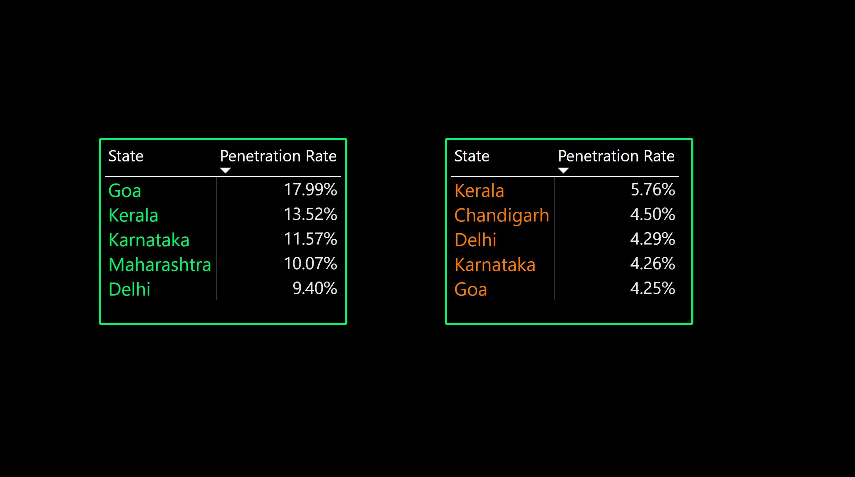
2. Identify the top 5 states with the highest penetration rate in 2-wheeler and 4-wheeler EV sales in FY 2024.
2 - Wheeler
4 - Wheeler

Slide 11
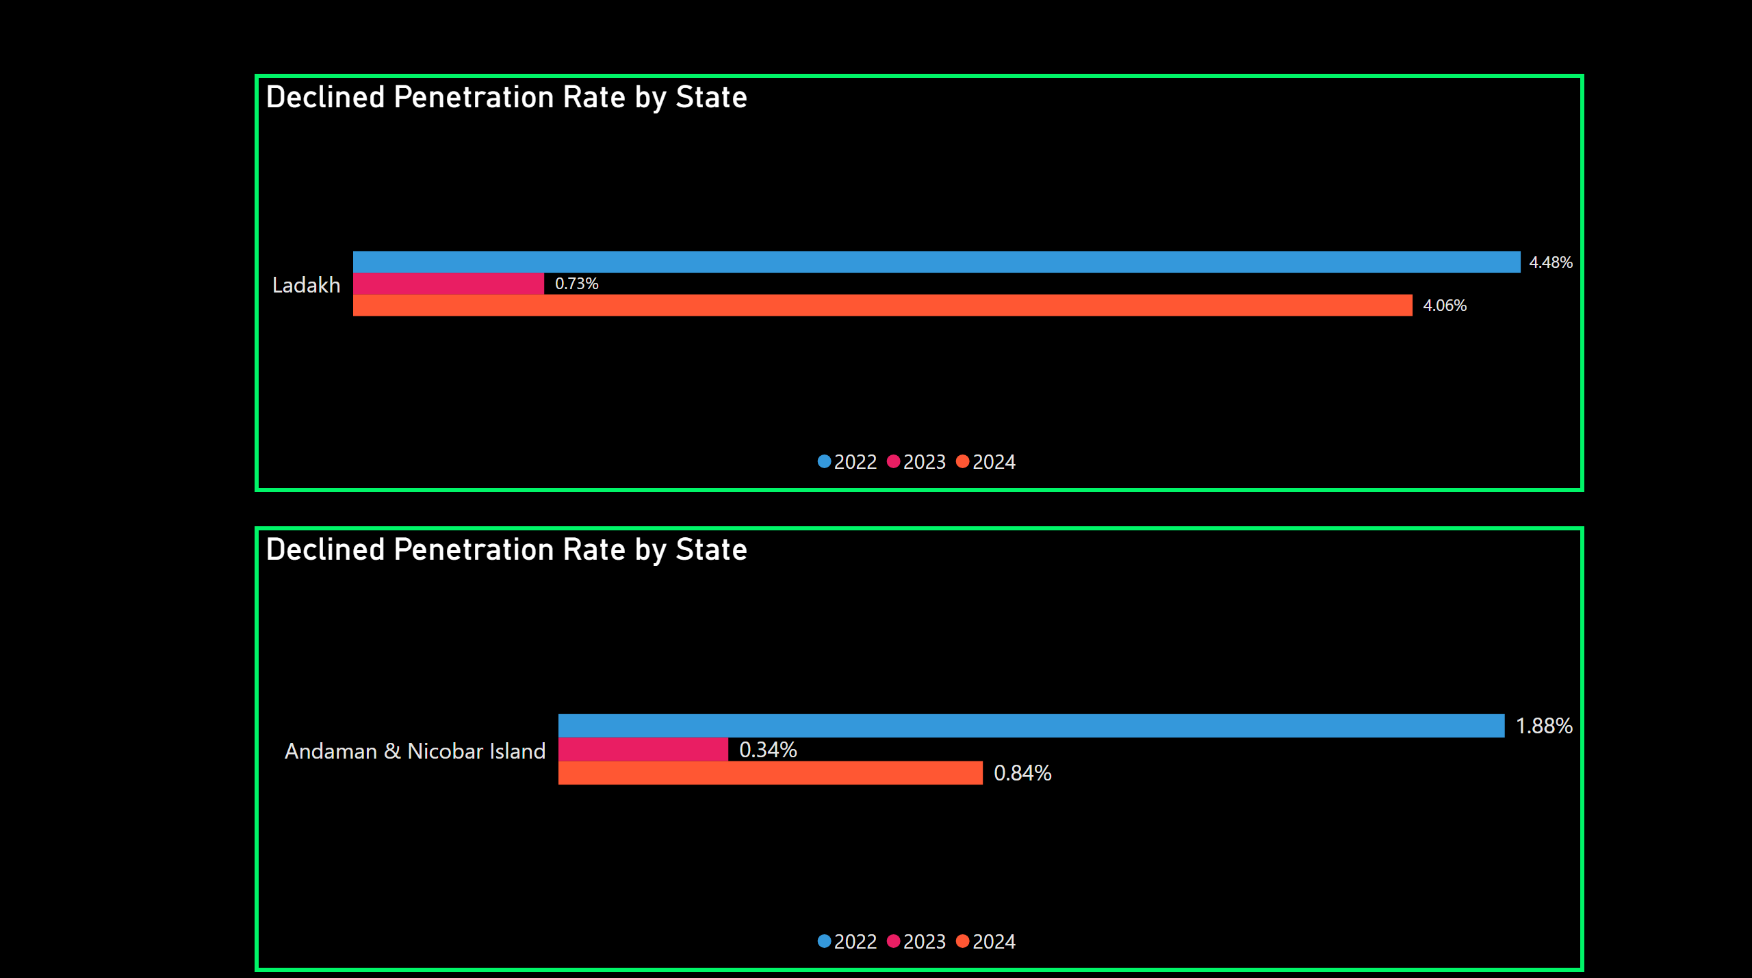
3. List the states with negative penetration (decline) in EV sales from 2022 to 2024?
2 - Wheeler
4 - Wheeler

Slide 12
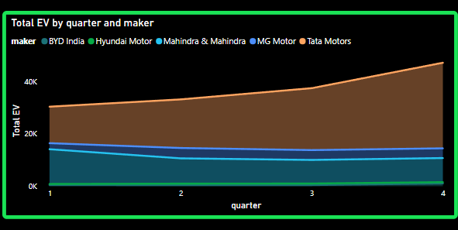
4. What are the quarterly trends based on sales volume for the top 5 EV makers (4-wheelers)
from 2022 to 2024?

Slide 13
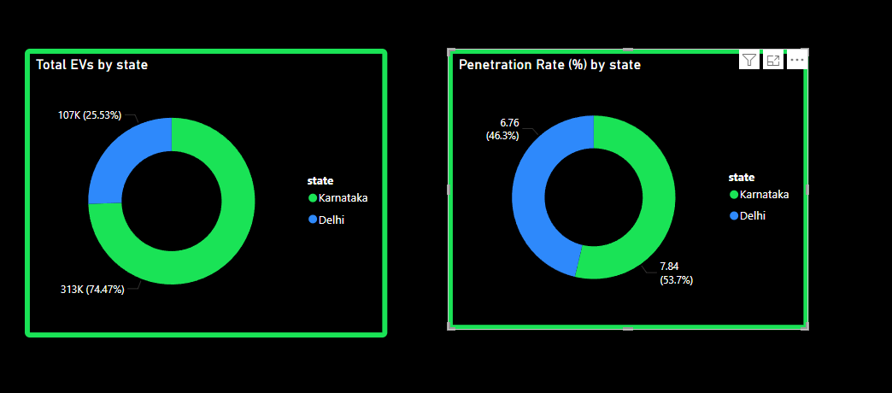
5. How do the EV sales and penetration rates in Delhi compare to Karnataka for 2024?

Slide 14
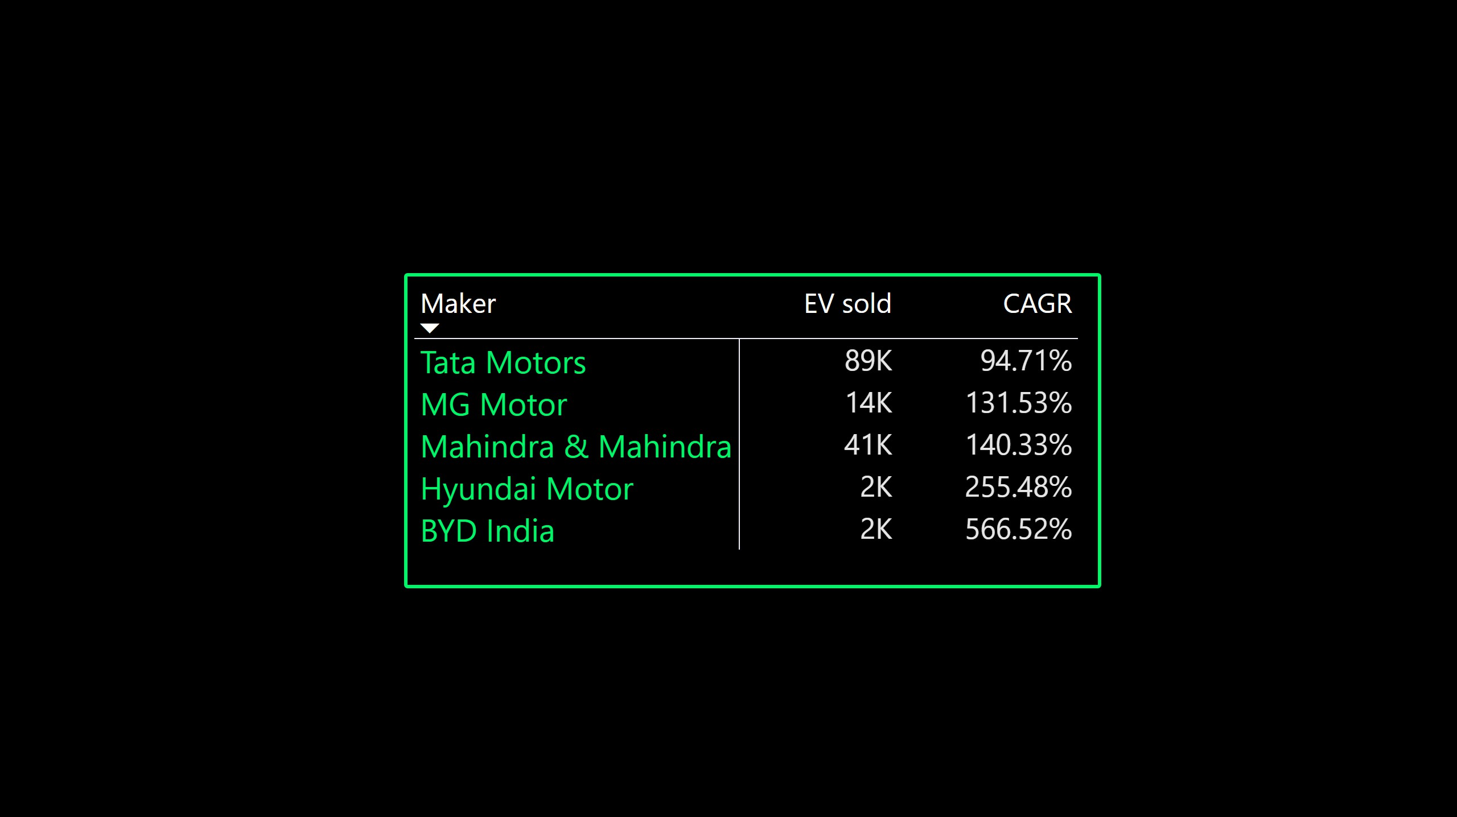
6. List down the compounded annual growth rate (CAGR) in 4-wheeler units for the top 5 makers from 2022 to 2024.

Slide 15
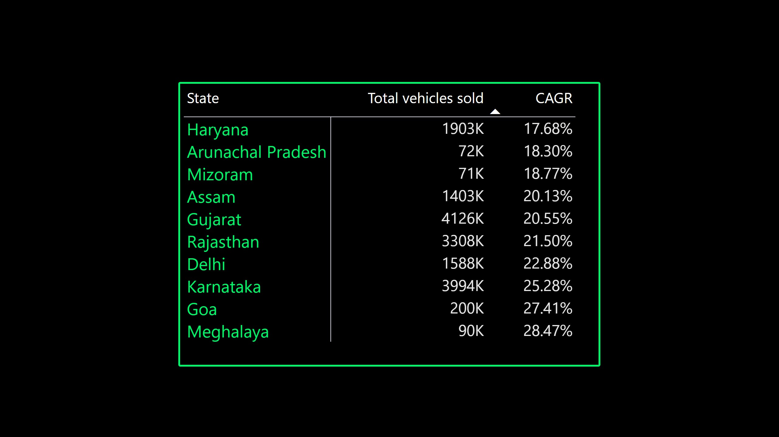
7. List down the top 10 states that had the highest compounded annual growth rate (CAGR)
from 2022 to 2024 in total vehicles sold.

Slide 16
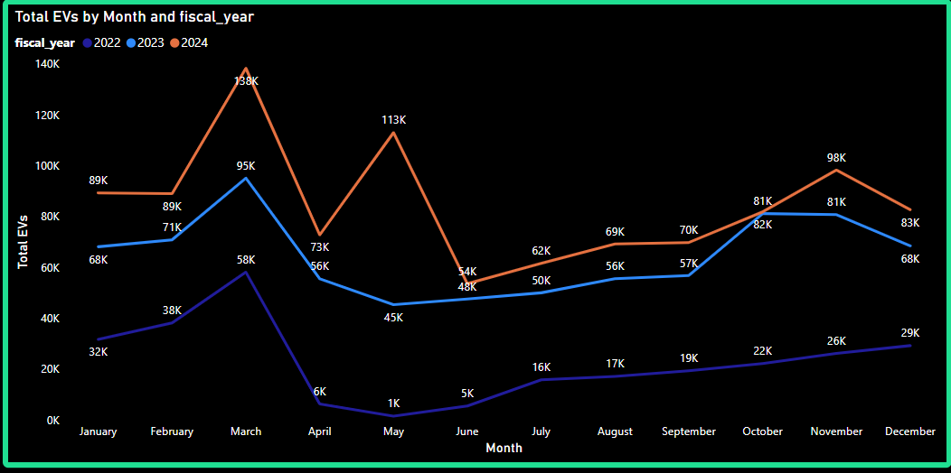
8. What are the peak and low season months for EV sales based on the data from 2022 to 2024?

Slide 17
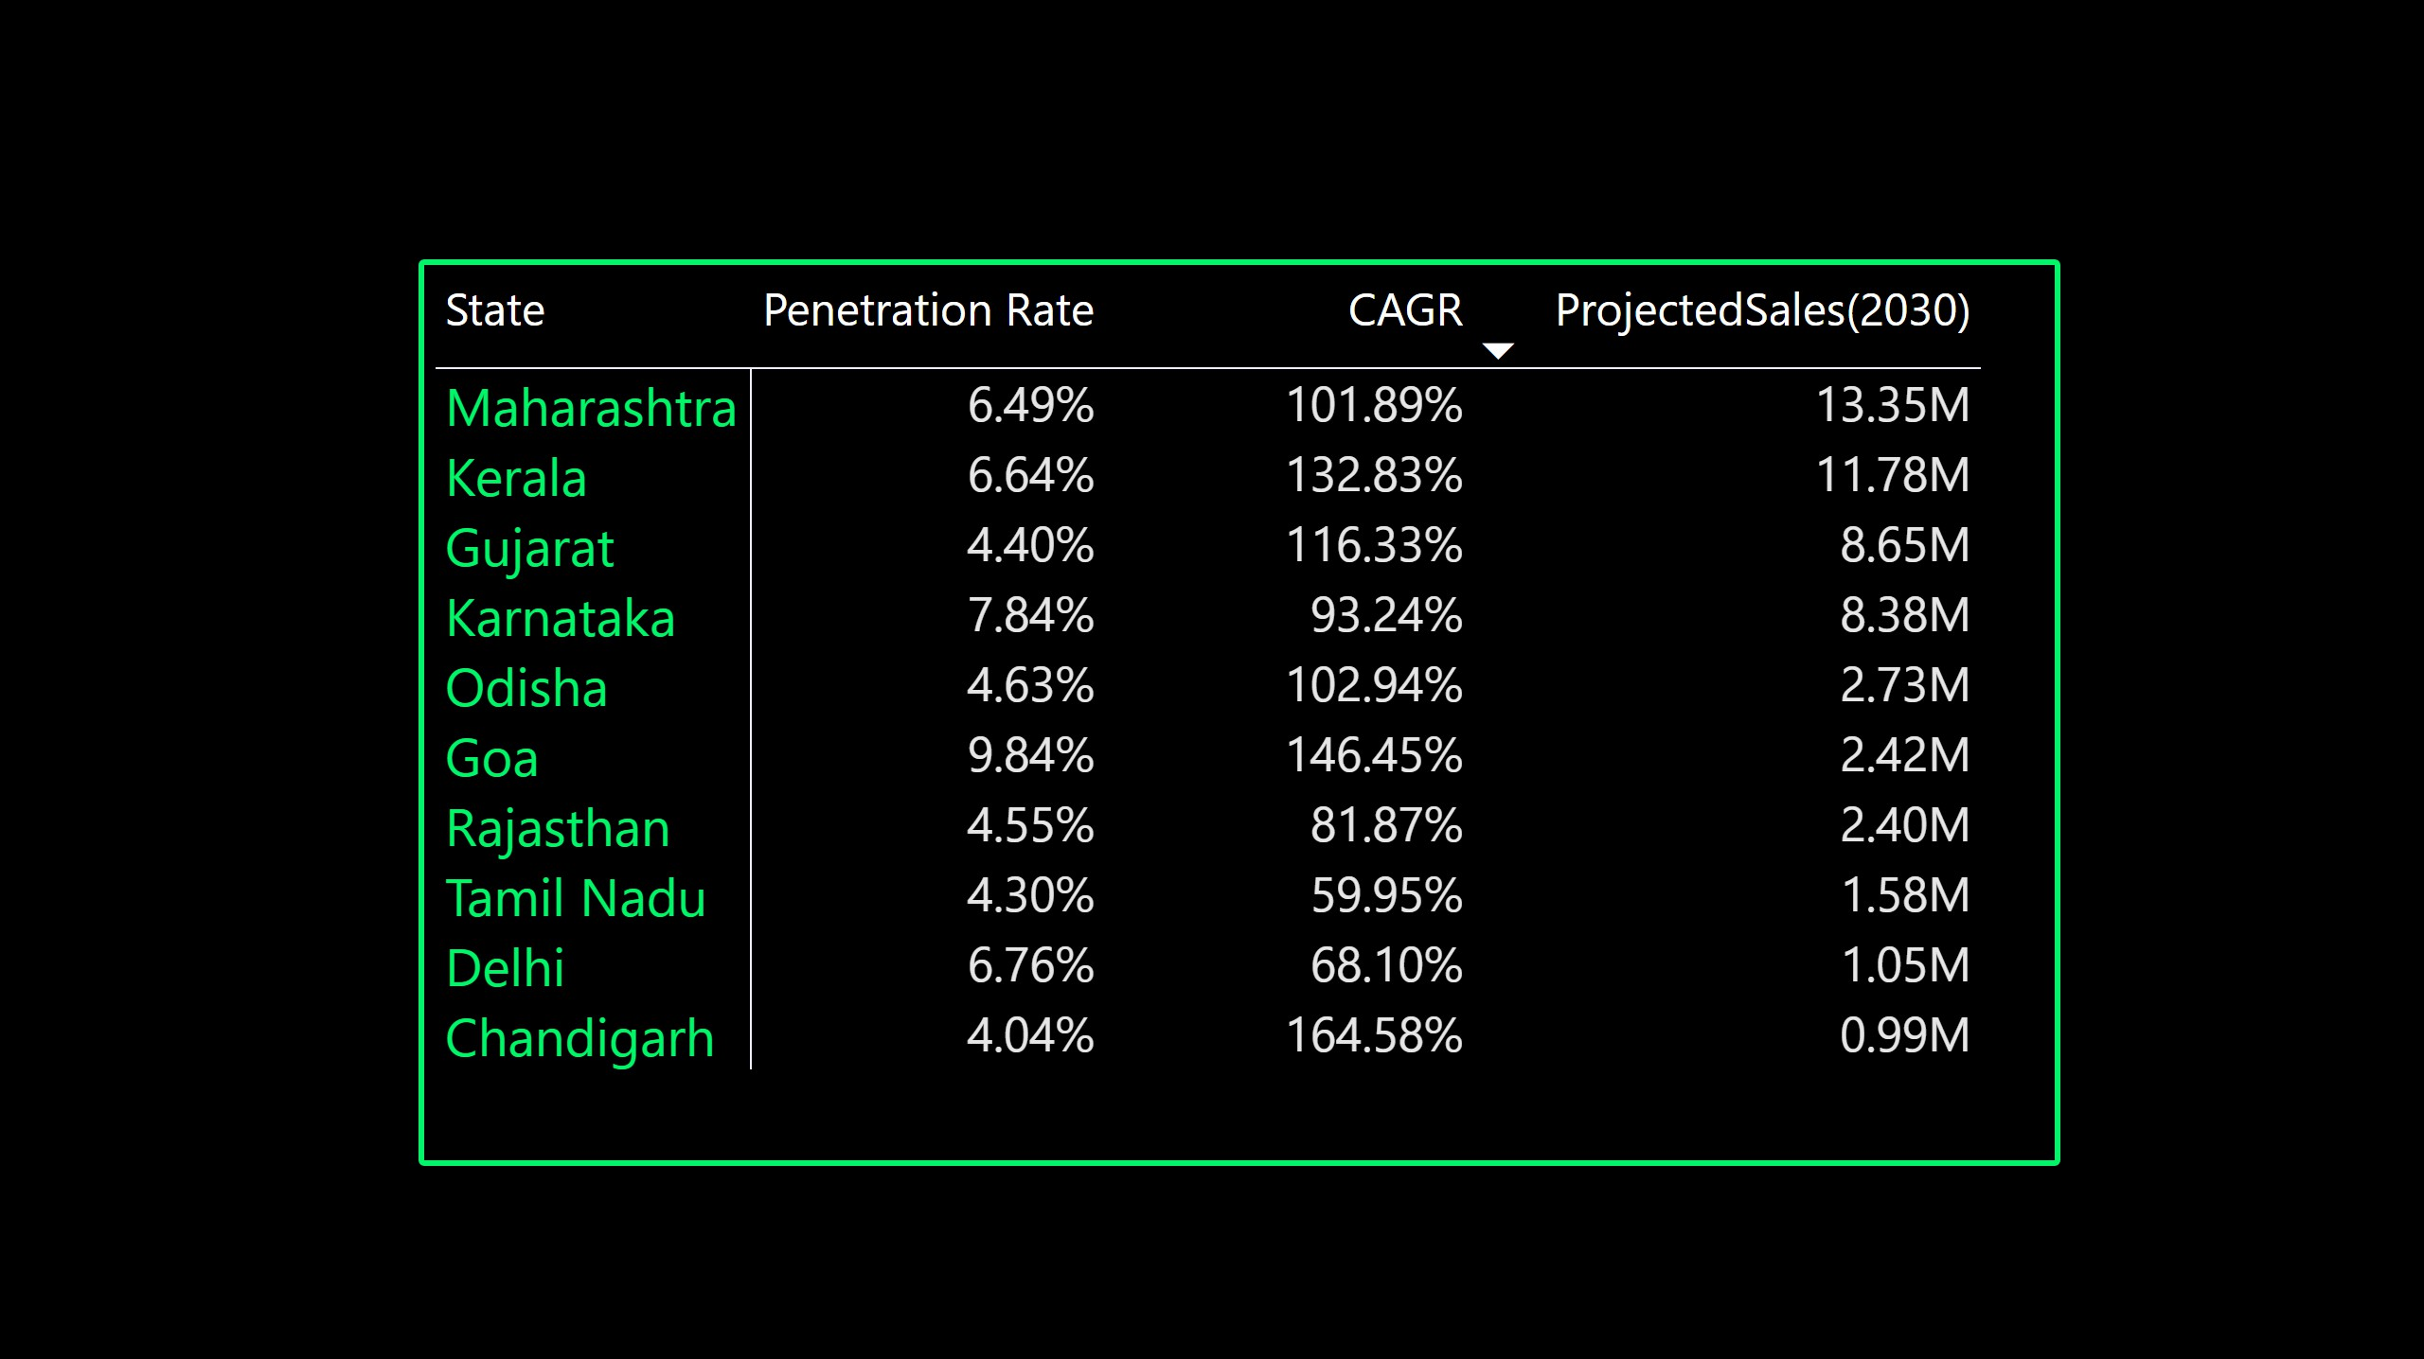
9. What is the projected number of EV sales (including 2-wheelers and 4- wheelers) for the top 10 states by penetration rate in 2030, based on the compounded annual growth rate (CAGR) from previous years?

Slide 18

10. Estimate the revenue growth rate of 4-wheeler and 2-wheelers EVs in India for 2022 vs
2024 and 2023 vs 2024, assuming an average unit price
Revenue Growth (2022 vs 2024)
Revenue Growth (2022 vs 2024)
Revenue Growth (2023 vs 2024)
Revenue Growth (2023 vs 2024)
2 Wheeler
4 Wheeler

Slide 19
Secondary Research Questions

Slide 20
1. What are the primary reasons for customers choosing 4-wheeler EVs in 2023 and 2024 (cost savings, environmental concerns, government incentives).
Cost Savings:
Fuel Efficiency: EVs consume significantly less energy compared to traditional vehicles, resulting in lower operating costs.
Maintenance: EVs require less maintenance due to their simpler mechanical components, further reducing long-term expenses.
Environmental Concerns:
Zero Emissions: EVs produce no tailpipe emissions, contributing to cleaner air and reduced pollution.
Sustainability: EVs are seen as a sustainable transportation solution, aligning with growing environmental consciousness.
Government Incentives:
Subsidies and tax benefits: The government provides subsidies on purchase prices, reduced road tax, and exemptions from registration fees to encourage EV adoption.
Faster registration and permits: Many cities offer expedited processes for EVs to streamline ownership.

Slide 21
2. How do government incentives and subsidies impact the adoption rates of 2-wheelers and
4-wheelers? Which states in India provided most subsidies?
Two-Wheelers:
The central government has extended the Electric Mobility Promotion Scheme 2024 until September 30, 2024, with an increased budget of ₹778 crore. Originally set from April 1 to July 31, 2024, this scheme offers subsidies of up to ₹10,000 for electric two-wheelers.
Additionally, the FAME-II scheme provides incentives for electric two-wheelers based on battery capacity.
Buyers can receive a subsidy benefit of up to ₹15,000 per kilowatt-hour (kWh) of battery capacity, capped at 40% of the ex-showroom price.
Four-Wheelers:
The FAME-II scheme also supports electric four-wheelers. However, the focus is primarily on two-wheelers and three-wheelers. The scheme aims to promote advanced technologies and encourages EVs equipped with advanced batteries.
State-level subsidies vary across India. Some states, such as Delhi, Maharashtra, and Karnataka, have been proactive in providing incentives for EV adoption. These incentives include registration fee waivers, road tax exemptions, and financial incentives for purchasing EVs.

Slide 22
3. How does the availability of charging stations infrastructure correlate with the EV sales and
penetration rates in the top 5 states?
Top 5 States in India with Significant EV Sales and Charging Infrastructure
Maharashtra
Delhi
Tamil Nadu
Gujarat
Karnataka
Correlation Between Charging Infrastructure and EV Sales
Range Anxiety Mitigation
Sales Growth
Public and Private Investment
Urban vs. Rural Dynamics

Slide 23
Which state of India is ideal to start the manufacturing unit? (Based on subsidies provided,
ease of doing business, stability in governance etc.)
Gujarat:
Subsidies and Incentives: Gujarat has become a hub for EV manufacturing, offering
attractive subsidies and incentives under its EV policy, which supports both manufacturers
and consumers.
Ease of Doing Business: The state ranks highly in the Ease of Doing Business index, with streamlined processes for setting up manufacturing units and obtaining necessary approvals.
Infrastructure: Gujarat has a well-developed infrastructure for manufacturing and
charging stations, making it conducive for EV production and sales.
Stability in Governance: The state has a history of stable governance.

Slide 24
Top 3 Recommendations for AtliQ Motors
Focus on High Penetration States:
Based on the research, AtliQ Motors should prioritize launching its EV models in states with high penetration rates for both 2-wheelers and 4-wheelers.These states already show a significant market acceptance and growth potential for EVs, indicating a higher likelihood of success and quicker market entry.
Enhance Charging Infrastructure Partnerships:
The correlation between charging station availability and EV adoption rates suggests that AtliQ Motors should partner with local governments and private companies to expand charging infrastructure, especially in high penetration states. This will enhance customer convenience and reduce range anxiety, fostering greater adoption.
Leverage Government Incentives and Subsidies:
AtliQ Motors should strategically utilize government incentives and subsidies that promote EV adoption. Launching vehicles in states with robust subsidy programs will make AtliQ’s offerings more competitive and attractive to customers. Additionally, aligning with government policies can provide financial benefits that reduce operational costs and increase profitability.

Slide 25
Conclusion
AtliQ Motors is poised to expand its presence in the Indian EV market by leveraging insights from our comprehensive market analysis. The research highlights significant opportunities in states with high EV penetration rates and suggests a strong link between charging infrastructure and adoption rates. To capitalize on these findings, AtliQ Motors should focus on:
Launching in strategically selected states with proven market demand.
Expanding partnerships to enhance charging infrastructure.
Utilizing government incentives to boost competitiveness and appeal.
By implementing these strategies, AtliQ Motors can establish a strong foothold in the Indian EV market, align with consumer trends, and achieve sustainable growth in this emerging sector.

Slide 26
.
THANK YOU !!
Powerbi File

